Slide 1


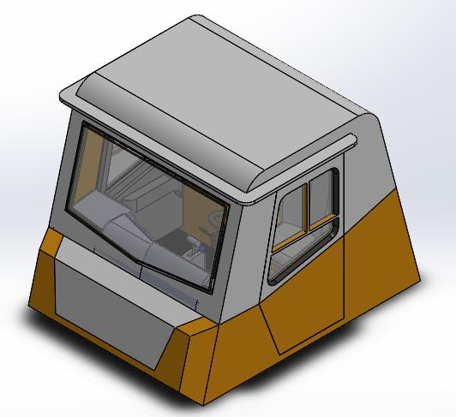
SENIOR DESIGN PROJECT
MINING TRUCK AIR MONITORING SYSTEM
Venkatesh Barakol - 01FE19BME112
Basavanagowda P N - 01FE19BME105
Shashank Deshpande - 01FE19BME111
Aniket R Joshi - 01FE19BME172
Akash Arkasali - 01FE19BME087
Abhishek Kulkarni - 01FE19BME139
Under the Guidance of
Prof. P.P.Revankar

Slide 2
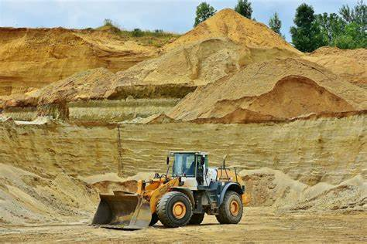
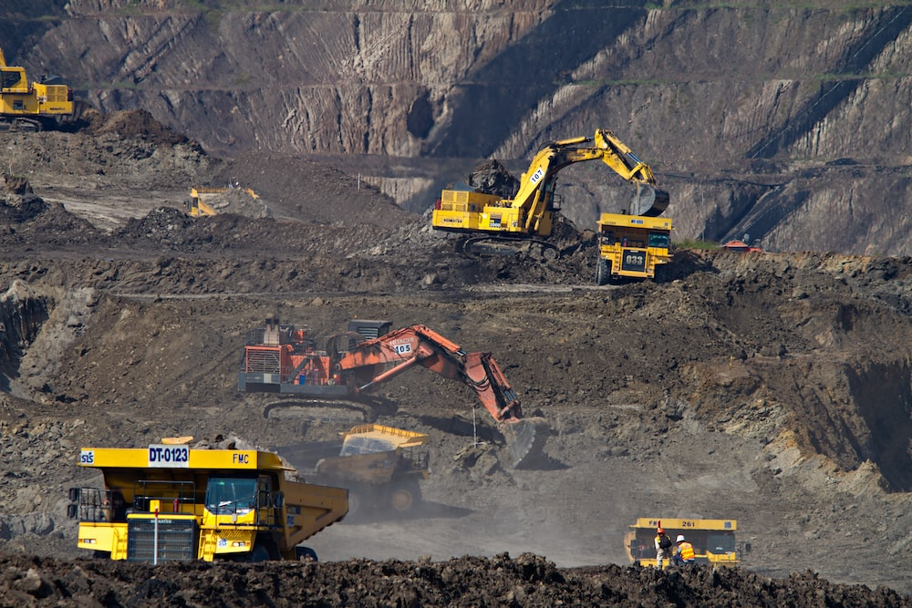
PROBLEM STATEMENT
Typically, truck drivers operate for long hours and at times in highly polluted environments like mines. Driver health and alertness while driving are key to avoiding accidents at the work site. Sometimes air quality deteriorates inside the cabin, and this could lead to driver fatigue.

Slide 3
LITERATURE SURVEY
In the past several decades, the effects of air pollution exposure on human health have been extensively studied, indicating that air pollution is a vital cause of increased morbidity and mortality.
1–3 People spend most of their time in indoor environments, including vehicle cabins.
The in-cabin micro-environment has become a significant source of exposure to various air pollutants, such as particulate matters (PMs), volatile organic compounds (VOCs), semi-volatile organic compounds (SVOCs), carbon monoxide, nitrogen oxides etc.

Slide 4
The quality of air in the cabins of Trucks operating in mines is affected by many factors .
In cabin, pollutants come from the outside environment or they are emitted directly inside the vehicles.
The main external sources of air pollution are the underground mining operations themselves (exploitation of resources) and diesel engine exhaust; oftentimes, the mine ventilation system is insufficient to remove this pollution .
Harmful pollutants from these sources may enter the cabin by infiltration, or they may be carried in by the cabin ventilation system.

Slide 5
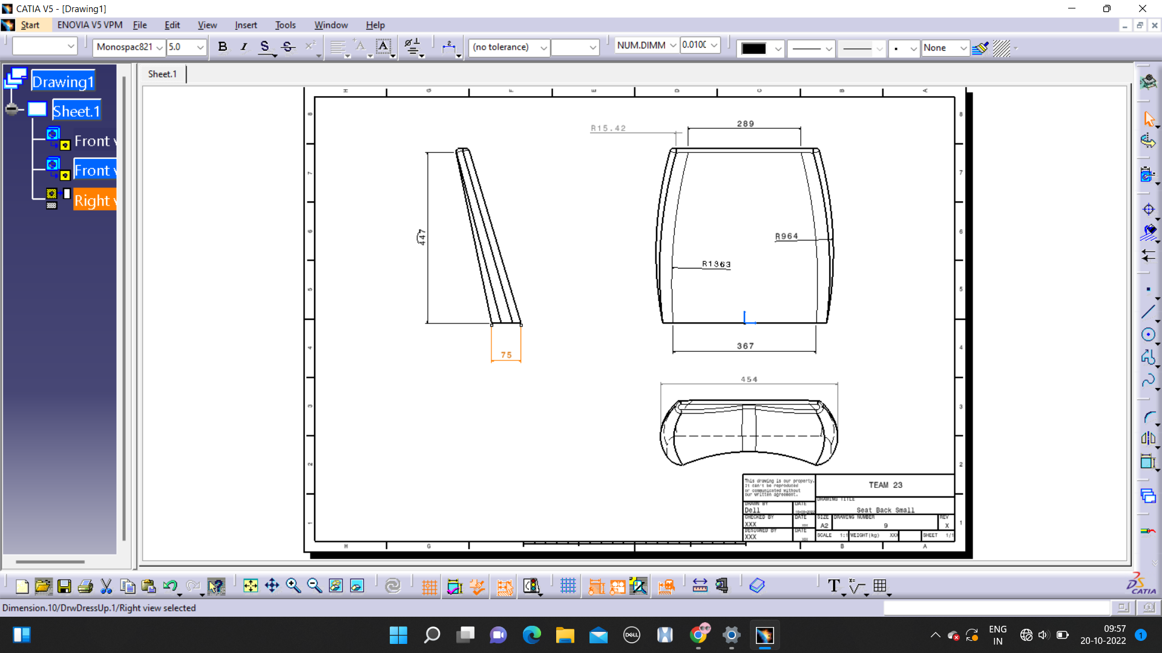
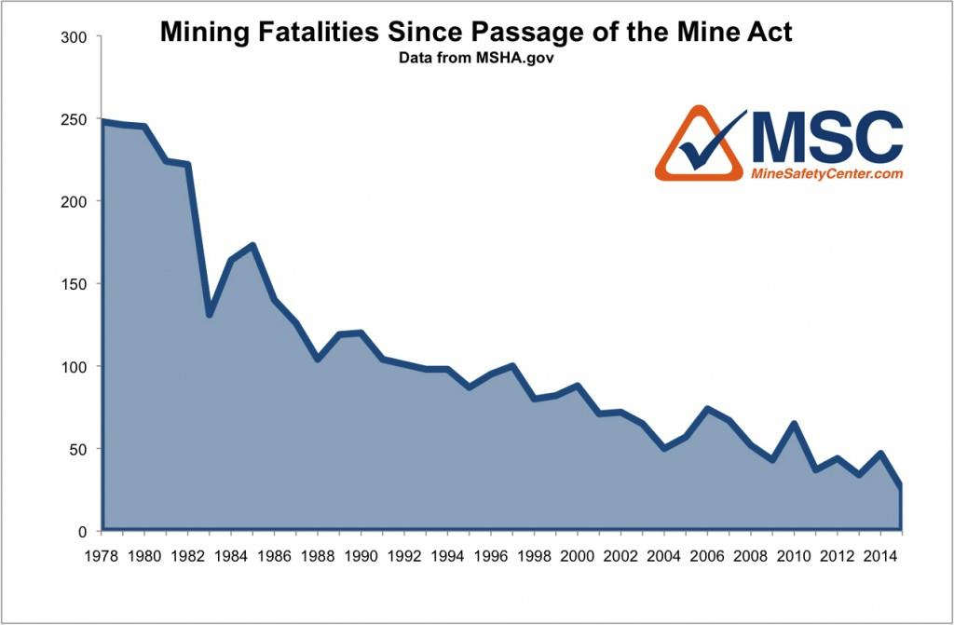
MINING FATALITIES SINCE PASSAGE OF THE MINE ACT
Graph from the year 1978 to 2014 illustrating the number of fatalities in mining zones
Fatalities
Year

Slide 6
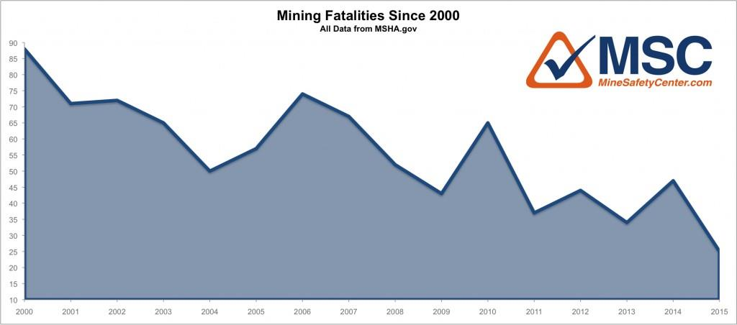
MINING FATALITIES SINCE PASSAGE OF THE MINE ACT
Graph showing the number of fatalities in mining zones from the year 2000 to 2015
Fatalities
Year

Slide 7
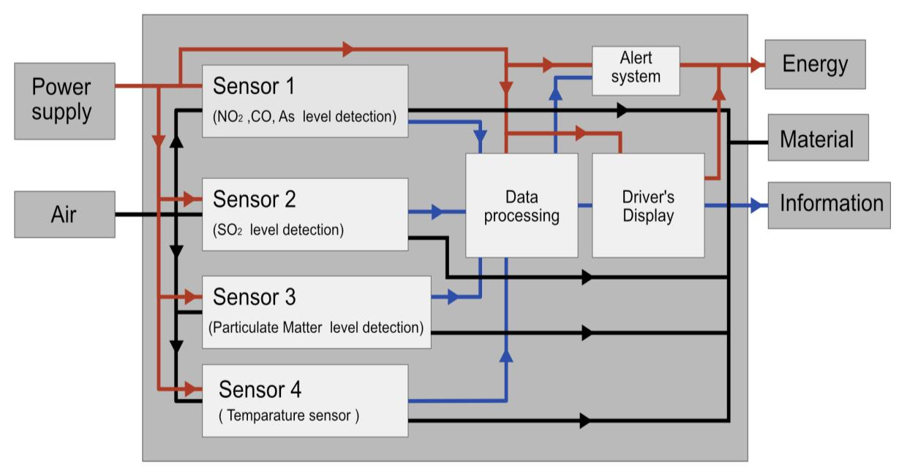
PRINCIPLE OF WORKING
The above figure illustrates the working flow of the device from the sensors to the microcontroller to the alert system and driver’s display.

Slide 8
3D CAD ASSEMBLY

Slide 9
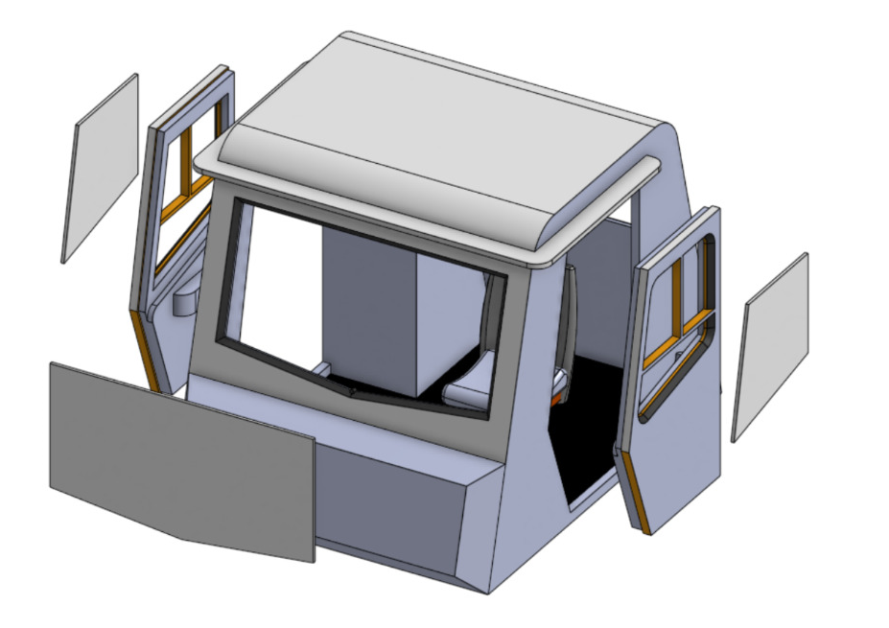
3D CAD ASSEMBLY(EXPLODED VIEW)

Slide 10
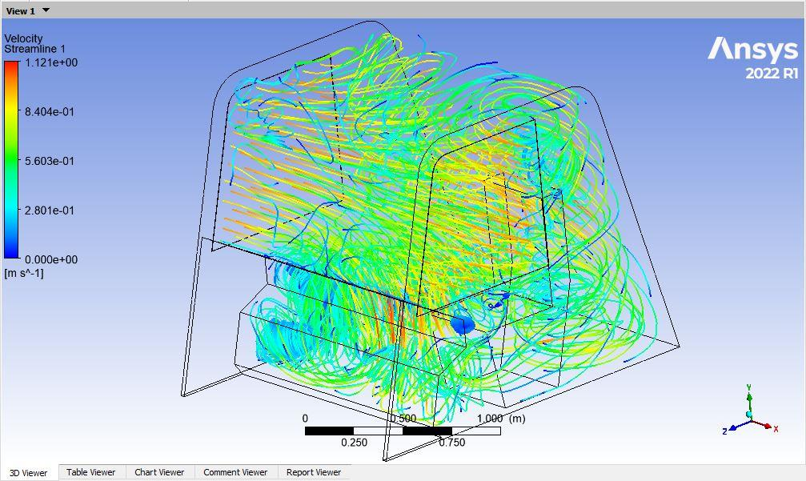
CAE ANALYSIS
Figure 1: Air intake through windows by adding streamline points.

Slide 11
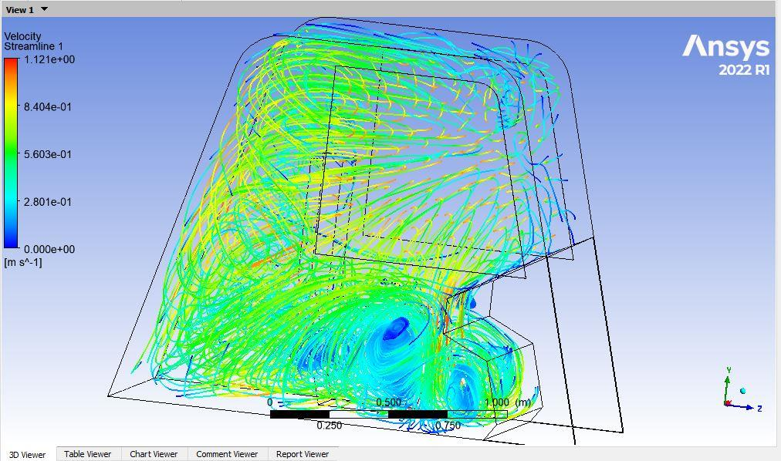
CAE ANALYSIS
Figure 2: Encircled area (blue region) velocity of air flow is 0.06 m/s.

Slide 12
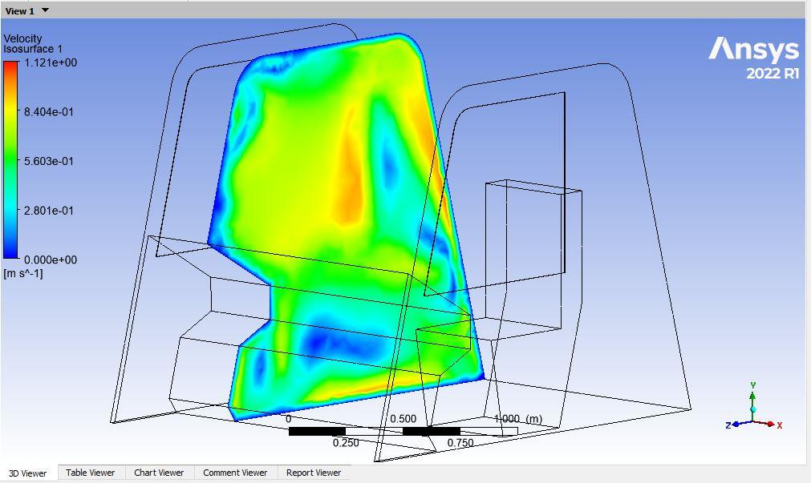
CAE ANALYSIS
Figure 3: Isosurface indicating the velocity of air flow at the distance of
0.4m from the window (air intake).

Slide 13
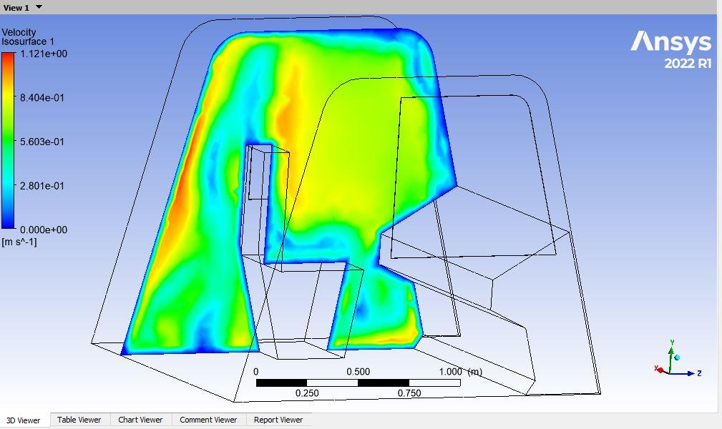
CAE ANALYSIS
Figure 4: Airflow velocity at the driver seating area is indicated by Isosurface.

Slide 14
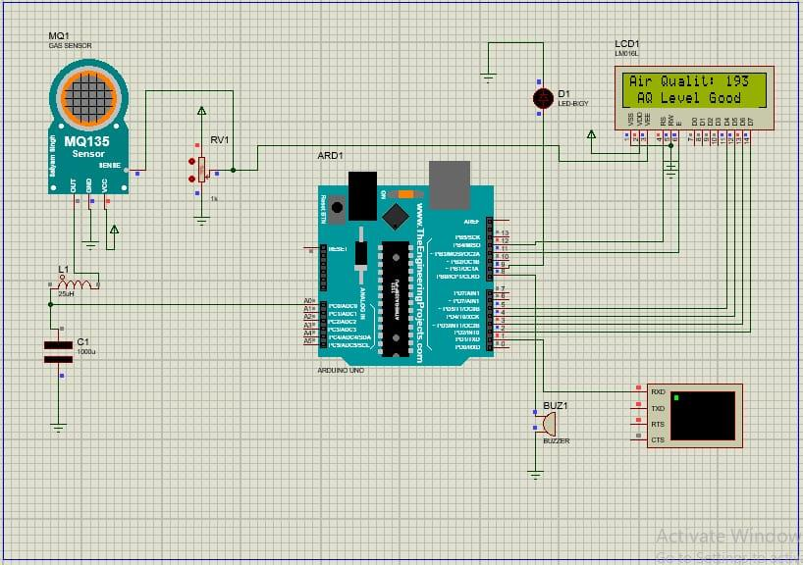
ELECTRONIC CIRCUIT AND SENSOR DETAILS
The electronics circuit module for air monitoring is prepared in the Proteas software.

Slide 15
Advantages:
Monitoring Pollutants like oxides of nitrogen(Nox), Carbon Monoxide, Ozone accurately.
It can alert drivers about the cabin environment.
Device is portable and compact.
Disadvantages:
Frequent calibration.
It could cost bit expensive.
Continuous power consumption.
Applications:
This system can be implemented in all trucks in mining areas to monitor air conditions in the cabins and can avoid the health distortions of the drivers.

Slide 16
Future Scope
In the future, we can link our air monitoring gadget with air purification systems so that the system automatically cleanses the air whenever the air quality within the cabin deteriorates.
With the help of an IoT strategy, real-time data that is fetched for this device can be updated.
In the near future, drivers' health metrics like heart rate and blood
pressure can also be measured by merging relevant technologies with our gadget, allowing for more effective monitoring of their health status.

Slide 17
THANK YOU

